Slide 1
FMI BLOCKCHAIN
ФМИ, СУ Александър Панайотов

Slide 2
За днес
Административни въпроси
Преговор
Екипи/идеи
Use cases. Приложение на БЧ
Токън стандарти
Ethereum Gas
Remix IDE
Smart Contracts – DEMO / Solidity

Slide 3
Оценяване
40% тест + 40% проект + 20% присъствие
Проект: макс. брой точки = n*6 / n-брой студенти /; сами разпределяте точките помежду си

Slide 4
Преговор

Slide 5
Where Can Blockchain Be Used
Banking
Business
Healthcare
Retail
Public sector
Cyber security
Games
IoT
Big data

Slide 6
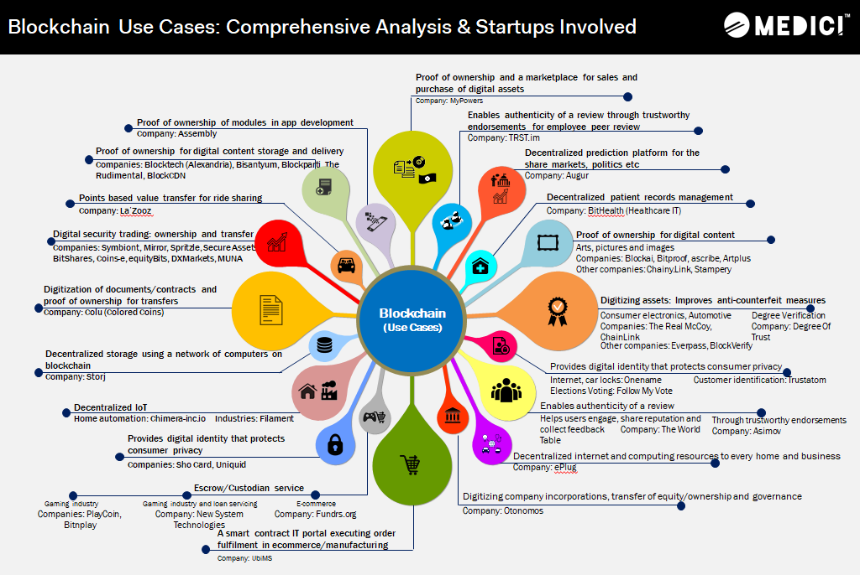
https://gomedici.com/uploads/30-non-financial-use-cases-blockchain-technology-1.png

Slide 7
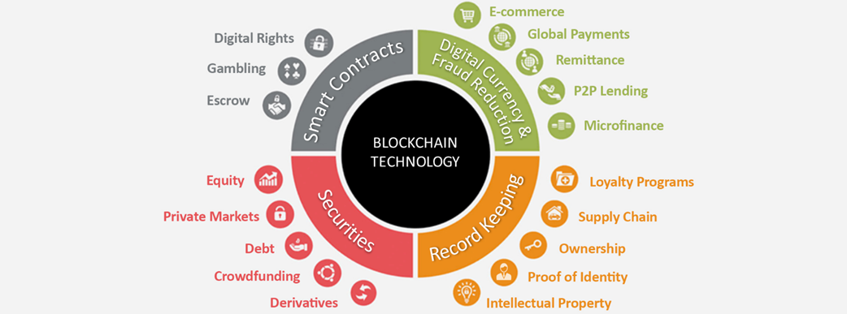
https://www.aciworldwide.com/-/media/images/general/blockchainforretailers1.png?h=387&w=1042&la=en&hash=4320F495B9D82352AD5FF7266F5F64016C36484A

Slide 8
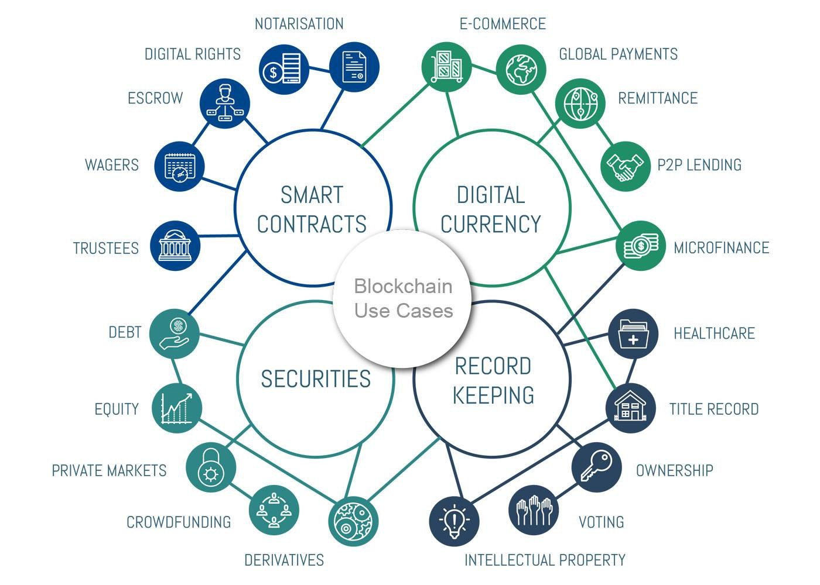
https://miro.medium.com/max/2800/1*Ce4yleNEJeVx2Z5xYhjHGg.jpeg

Slide 9
Tokens
Utility
Equity
ERC-20 - fungible
ERC-721 - non-fungible

Slide 10
Smart contracts (1)
Autonomy (self-execution)
Efficiency ( no intermediaries)
Backup (multiple ledger copies)
Accuracy (deterministic code)
Cost saving (no intermediaries)
Transparency (public ledger)

Slide 11
Smart contracts (2)
Smart contracts == Firmware != regular code
Update/Change/Patch == Create new
Proxy
Kill switch / self-destruct
SC testing time = 5 * reg soft testing time

Slide 12
Ethereum Gas
Uility token
TXs fees
Balances ETH price fluctuations
No infinite loops and operations

Slide 13
Remix DEMO
https://remix.ethereum.org/

Slide 14
Thank you!

